Slide 1
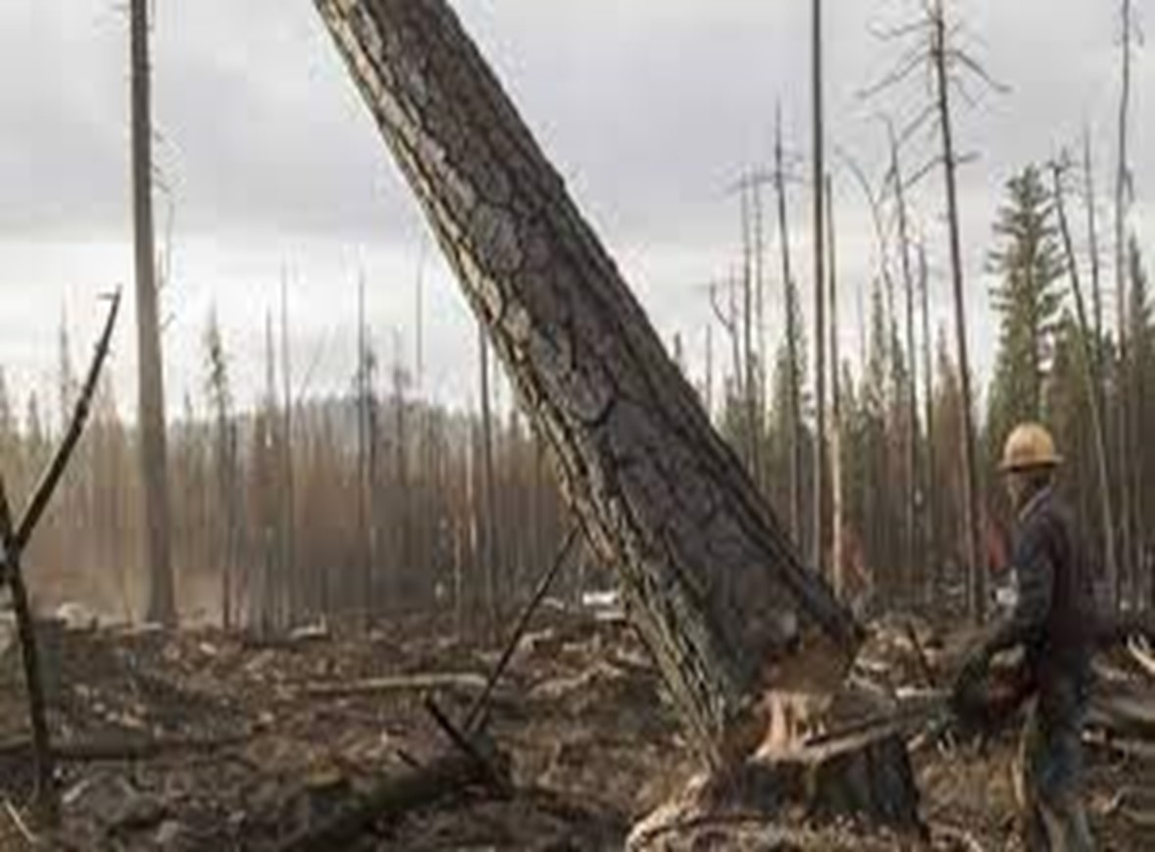

Department Of Computer Science And Engineering Project Review – I (18CSP77) PROJECT ON PROTECTION OF FOREST TREES AGAINST POACHING BASED ON IOT Batch No:2021_CSE_26 Team Members Under the guidance of Vijay N S 1KS18CS115 Dr. K. Venkata Rao Pullur Pavan Kumar 1KS18CS074 Professor Nitish Kumar 1KS18CS063 Dept. Of CSE, KSIT Sandeep kumar 1KS18CS087
K.S.INSTITUTE OF TECHNOLOGY
1

Slide 2
CONTENTS
Introduction
Literature Survey
Problem Identification
Goals and Objectives
Methodology
Contribution to Society
References

Slide 3
INTRODUCTION
In recent years poaching or smuggling of environmentally and economically important species of trees in forested areas- such as Sandalwood, Teakwood, Pine and Rosewood has been tremendously increased.
There have been several initiatives undertaken by different stakeholders-- and in particular – by the Govt. of India, to mitigate these problems.
The main idea presented in this paper is to design a portable wireless sensor node which is a part of wireless sensor Network.
It will be mounted on trunk of each tree, capable of detecting theft as well as automatically initiate & send alarm signals if any to remote terminal through wireless media.

Slide 4
LITERATURE SURVEY
Sl.No | Title | Author | Journal And Publications Year | Methodology | Objectives
1 | Anti-Poaching of Trees in Forest-Based on IoT | S. Sanjay Kumar¹, V. Ravi¹, Ch. Rajendra Prasad¹ and P. Ramchandar Rao | IJEAT 2018 | Paper suggests gyro sensor to detect the inclination of the tree which are being cut) | design a framework or system which will be utilized to restrict the sneaking of sandalwood trees
2 | Preventive System for Forests | Prasad R. Khandar | IJCST 2018 | Paper suggests to use microcontroller, Zigbee Module at the tree

Slide 5
Sl.No | Title | Author | Journal And Year | Methodology | Objectives
3 | Forest protection using wireless sensor network and IoT | Gyanaranjan Patra | 2018 | It empowers remote checking conditions inside the wood | Detection of the forest fire
4 | An IoT based fire alarming and authentication system for workhouse using Raspberry Pi 3 | Imteaj | 2017 ECCE | Raspberry Pi 3 id used to control multiple Arduino integrated with sensors and camera | A system which detects fire and provides the location of the affected region
5 | IOT enabled forest fire detection and online monitoring system | Abhinav Kumar Sharma1 ,MdFaizRaza Ansari | 2019 | a system which detects fire and provide location and image of the affected trees | Detection of fire near tree and detect location to prevent accidents

Slide 6
Sl.No | Title | Author | Journal And Year | Methodology | Objectives
6 | Handover based spectrum allocation in cognitive radio networks | M. Suganya | 2018 | the capacity of the cognitive radio network is maximized by coordinating SUs handover decision optimally in the PU-SU coexisted cognitive radio networks | Improve the quality of communication of radio signals
7 | Implementation of a Forest Monitoring and Alerting System | Akhil Gunda, Shreya Lokray, Vaishnavi Suthram | 2020 Irjet | connect sensors to NodeMCU Setup raspberry pi Make establishment between Raspberry Pi and NodeMCU using MQTT Protocol | The sensors accelerometer, tilt sensor, sound sensor and temperature-humidity sensor should extract accurate readings from the surroundings

Slide 7
S.No | Title | Author | Journal And Publications Year | Methodology | Objectives
8 | Preventive system for forests property using wireless communication | Korapati Prasanti; Kalpana Seelam; Ch. Jayalakshmi; Chandra Sekhar Savalam | 2019 ICACCS | The Sensors Used are PIR, Flex , Force Sensitive Resistor and Signal Conditioner | someone is moving into the area of bunch trees the PIR sensor produces an signal and if they cut trees immediately FSR and Flex sensors are also produce signal
9 | Zigbee Based Intelligent Forest Monitoring System Using Wireless Sensor Network | Santhanam Suganthi, Palevesanadar Thiruvalar Selvan | 2020 WAFFEN-UND KOSTUMKUNDE JOURNAL |  | f this system has alarm to alert the human to prevent the theft and falldown of tress in forest with support of GPS receiver to locate the position of service need

Slide 8
s.No | Title | Author | Year and Publication | Methodology | Objectives
10 | Using Long-Range Wireless Sensor Network to Track the Illegal Cutting Log | Giva Andriana Mutiara , Nanna Suryana Herman and Othman Mohd | 2020 MDPI | An Arduino Uno, Raspberry Pi 3 B+, sound sensor, accelerometer sensor, LoRa GPS HAT Shield, and Outdoor LoRa Gateway OLG01 performed the hardware monitoring and tracking of the proposed system | The result determined that the LoRa can detect and identify the occurrence of the illegal cutting of logs in real-time

Slide 9
LITERATURE SURVEY
1.Title: “Anti-Poaching of Trees in Forest-Based on IoT”
Authors: S. Sanjay Kumar , Year:2018
The primary goal of this paper is to design a framework or system which will be utilized to restrict the sneaking of sandalwood trees. A system can be developed using a gyro sensor(to detect the inclination of the tree which are being cut), thermistor sensor(NTC 10k),esp8266 device(Wi-Fi device) and GSM Module, to restrict smuggling and to track the trees much easy. These sensors data will consistently check with the Thingspeak cloud platform. The obtained data is stored in Thingspeak Server with using of the esp8266 module. Forest officials get alert when any event occurs so that appropriate operation will be taken.

Slide 10
2. Title: Preventive System for Forests
Author: Prasad R. Khandar , Year:2018.
Three distinct units are placed in proper places for performing experimental test. fully setup of system is established. Stroke has been given and it is being detected by tree unit. Further processing of signal is done by sub server unit. For understanding purpose LCD display we have attached. At control station where main unit is fixed, detected signal is successfully received by GSM module. For displaying purpose GUI is maintained which will display a message or alarm indicating that particular tree is undergoing non-bearable pressure.

Slide 11
3. Title: “Forest protection using wireless sensor network and IoT”
Authors: Gyanaranjan Patra, Year:2018.
In this paper we center on backwoods firefighting activities, proposing 3 completely appropriated methods for approximating the genuine state of fire. In the least complex methodology, a circular burnt territory is expected around every hub which has identified the fire and association of circles gives the general fire’s shape. So this undertaking manages the improvement of a smart constant and programmed early admonition framework for woods fire. It empowers remote checking conditions inside the areas of the wood and makes a ready when a backwoods fire is distinguished by distinctive mail as well as SMS, and from the sensor information is always observed alongside a GPS area for every sensor hub which is associated by Zigbee modules able to do long-range of transmission, basic battery observing framework permits consistent checking of intensity use of the whole arrangement.

Slide 12
4. Title: “An IoT based fire alarming and authentication system for workhouse using Raspberry Pi 3”
Author: Imteaj, Year:2018.
In this paper, we have propounded a system which is capable to detect fire and can provide the location of the affected region. Raspberry Pi 3 has been used to control multiple Arduino which are integrated with a couple of sensors and camera. A 360° relay motor is assembled with the camera so that it can snap the image in whatever angle the fire is detected. We have provided a confirmation of the fire suspecting system to avoid any false alarm. The system will immediately send a message along with the image of the affected spot and Arduino's location.

Slide 13
5. Title: “IOT enabled forest fire detection and online monitoring system”
Author:Abhinav Kumar Sharma1 ,MdFaizRaza Ansari2 , Year:2019.
It has been found in a survey that 80% losses caused due to fire would have been avoided if the fire was detected immediately. Arduino platform based IoT enabled fire detector and monitoring system is the solution to this problem. In this project, we have built fire detector using Arduino Uno which is interfaced with a temperature sensor, a smoke sensor and buzzer. The temperature sensor senses the heat and smoke sensor senses any smoke generated due to burning or fire. Buzzer connected to Arduino gives us an alarm indication. Whenever fire triggered, it burns objects nearby and produces smoke.Afire alarm can also be triggered due to small smoke from candlelight or oil lamps used in a household. Also, whenever heat intensity is high then also the alarm goes on.

Slide 14
6.Title: “Handover based spectrum allocation in cognitive radio networks”
Author:M. Suganya , Year:2018
There is a rapid development in wireless technologies with the increase of congestible frequency spectrums, research study reveals that there is a problem in spectrum management and spectrum allocation. To overcome this problem there is a new technology known as cognitive radio technology in wireless sensor networks called as CWSNs. The first standard for cognitive radio networks is IEEE 802.22, but this standard cannot overcome the problem of spectrum management and spectrum allocation. In this paper we propose a novel protocol in which spectrum allocation can be done by increasing the transmission range and communication quality, lowering the energy consumption and delays.

Slide 15
PROBLEM IDENTIFICATION
Smuggling/theft of most important trees such as sandal wood in forests, poses a serious threat to forest resources, causes significant economic damage and ultimately has quite a devastating effect on the environment all over the world.
Smuggling not only cuts into the legitimate profits of the sandalwood and state revenue, it also threatens a valuable natural resource and threatens the communities living around the forests.
Most forest fires are atmospheric temperature and occasional humidity which provide auspicious environments for fire to begin.
Common causes of forest fire include lightning, human carelessness and exposure of fuel to extreme heat and aridity.

Slide 16
GOALS AND OBJECTIVES
The main objective of this project is to developing such a system which can be used to restrict this smuggling.
The main idea presented in this project is to design a portable wireless sensor node which is a part of wireless sensor Network.
It will be mounted on trunk of each tree, capable of detecting theft as well as automatically initiate & send alarm signals if any to remote terminal through wireless media.
We are developing such a system which can be used to restrict this smuggling.
In this system a novel method has been introduced to prevent the cut down of trees using wsn and blynk

Slide 17
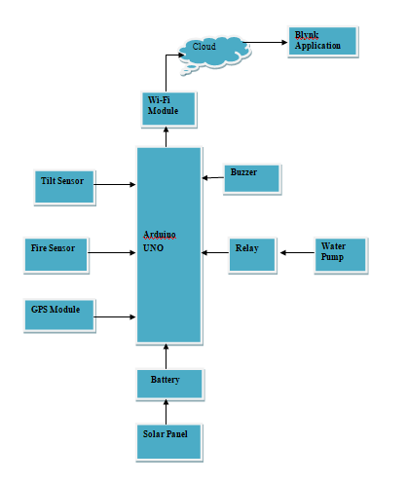
METHODOLOGY

Slide 18
In this system we have given an idea to detect the fire in the forest by using modern equipments. The system is proposed to detect the fire in the forest and also to alert the forest officer about the fire in the forest.
Here a microcontroller is used to control the system activities, some sensors are used to detect the fire in the forest, with detecting the fire the exact location of the fire is detected and located to the nearby forest officer.
So the system is a complete IoT based system were the activities of the system is continuously monitored and the monitoring details are stored in online pages which is viewed by the officer regularly.
The details are stored as a data and this data can be viewed at any time.
The solar panel with a battery is used to supply the source to the system. Since the system is designed to implement in the forest it not possible to provide power supply through transmission line hence a solar panel is used which can be charged and stored in a battery. It is given as source to the system.

Slide 19
The tilt sensor is used to know smuggling or cutting of the tree , the buzzer is used as a alaram to notify.
The GPS is find the exact location if any forest fire or smuggling or cutting of the tree is happen in the forest.

Slide 20
CONTRIBUTION TO SOCIETY
The idea was to involve local people in patrolling and awareness raising to reduce illegal activities in wildlife reserves and national parks.
Since implementation communities are actively participating in anti-poaching operations, with poaching greatly reduced.
So Our Project also useful to reduce the pouching of Sandalwood and other expensive trees

Slide 21
REFERENCES
[1] Journal /Article /Paper Hameem C Hamza Tree Theft Control System 2013 Texas Instruments India Educators Conference.
[2] Ghousia Sultana B IOT Based Anti-Poaching Alarm System for Trees in Forest using Wireless Sensor Network Volume 9, Special Issue No. 3, May 2018.
[3] Subhashini A Smuggling preventions system for trees in forest using IOT Chennai International journal of scientific research and innovations IX (2018) 15-22.
[4] Mr V. Narasimman Asst.Prof Design of a WSN node for forest trees against poaching.
[5] B S Sudha Yogitha Forest monitoring system using Wireless Sensor Network Volume 4, Issue 4 April2018.

Slide 22
[6] M. Lee, J.wang and H. Yoe, "Agricultural Production System Based on IoT," 2013 IEEE 16th International Conference on Computational Science and Engineering, Sydney, NSW, 2013, pp. 833-837.
[7] J. Grand C. Molina-Colcha, S. Hidalgo-Lupera and C. Valarezo "Design and Implementation of a Wireless Sensor Network for Precision Agriculture Operating in API Mode," 2018 International Conference on eDemocracy & eGovernment(ICEDEG), Ambato, 2018, pp. 144-149.
[8] S. Gio, I. Seitanidis, M. Ojo, D. Adam and F. Ving, "IoT solutions for crop protection against wild animal attacks," 2018.

